Slide 1
Web Development with Php

Slide 2
What is Php ?
PHP: Hypertext Preprocessor (or simply PHP) is a server-side scripting language designed for Web development, and also used as a general-purpose programming language
What are Scripting Languages:
A scripting or script language is a programming language that supports scripts programs written for a special run-time environment that automate the execution of tasks that could alternatively be executed one-by-one by a human operator

Slide 3
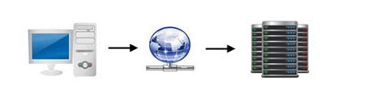
Types of Scripting Languages:
Server Side Scripting Languages.
Client Side Scripting Languages.
Server Side Scripting Languages:
When a client makes a request for a webpage that information is processed by the web server. If the web page contain (php) then first the script is executed first then then return to the client.

Slide 4
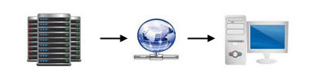
Client Side Scripting Languages:
Once the client receives the return information from the server if it contain a client side script (e.g javascript) Your Computer browser executes the script before display the web page.
Two Types of Web pages:
1.Static Web Pages.
2.Dynamic Web Pages.

Slide 5
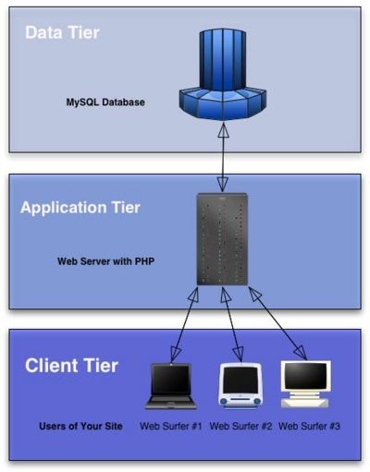
Three Tier Web Applications:

